Slide 1

DS 501
Case Study No.3
Group 10
Jiexuan Sun,
Chao Xu,
Zhaoning Su,
Congyang Wang
Notes:
Good evening everyone, Professor Paffenroth, we are group 10, I’m Congyang, these Jiexuan, Chao, Zhaoning, this is the second time we come here to share with you, We are so happy, ok, let’s start this talk with this cover, there are 448 movie posters on screen, which the movies I watched and reviewed in past 10 years. We do this for a little long time but it worth because we love the movie so much .
*: I am a honest man, so I even use this poster twice to make this this happened.
*: You know, for some reason, it’s more easier to watch the movies around the world Hollywood, Bollywood and so on.

Slide 2
content of table
content of table
1
Motivation about the data
How did we analyze the data
What did we find in the data
Further try
2
3
4

Slide 3
The motivation about the data
1
Motivation about the data
How did we analyze the data
What did we find in the data
Further try
2
3
4

Slide 4







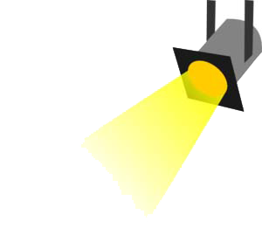

1
The motivation about the data
No.1
No.2
No.3
No.4
We are four data scientists from 21th Century Dogs
We love movie
We love data
We report to our BOSS
Define the right movie
Make right movie.
Notes:
Our CEO Mr. Paffenroth.
We just finished our first job to analysis of the movie rating users profile last month, and this time we will analysis inside of the movie reviews , the textual analysis of movie reviews.(引进新的电影, 看什么是好的电影.) (target)

Slide 5
How did we analyze the data
1
Motivation about the data
How did we analyze the data
What did we find in the data
Further try
2
3
4

Slide 6






2
How did we analyze the data
Positive
Movie Review Data
Negative
Notes:
We got the dataset with label Positive and Negative, XXX will show the test result later,
We use Scikit learn, the best package of Python for machine learning, the matplotlib to visualize the result, and the Plotly another python package( I love python 😄) for the final interactive plot.
Of course, in the future we may do more research and make more money for our CEO.
*: point to Paffenroth
XXX will introduce this to you, XXX

Slide 7
What did we find in the data
1
Motivation about the data
How did we analyze the data
What did we find in the data
Further try
2
3
4
Notes:
We made several basic test to the data…… we know you guys did the same test, so I will make this part fast.

Slide 8
3
What did we find in the data
Introducing TfidVectorizer (1)
1. TF-IDF (term frequency–inverse document frequency)
2. Scikit-Learn_TfidVectorizer
3. Key parameters in TfidVectorizer
min_df
max_df
Ngram_range
Used for removing terms that appear too infrequently
Used for removing terms that appear too frequently
Limit the boundary of the range of n-values for different n-grams to be extracted.
Notes:
We made several basic test to the data…… we know you guys did the same test, so I will make this part fast.
In information retrieval, tf–idf, short for term frequency–inverse document frequency, is a numerical statistic that is intended to reflect how important a word is to a document in a collection or corpus.^{[1]:8} It is often used as a weighting factor in information retrieval and text mining. The tf-idf value increases proportionally to the number of times a word appears in the document, but is offset by the frequency of the word in the corpus, which helps to adjust for the fact that some words appear more frequently in general.

Slide 9
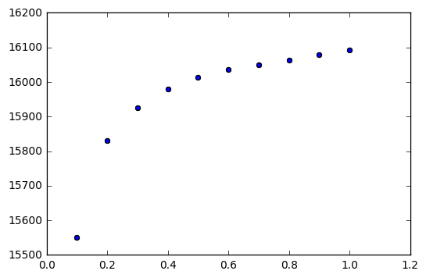
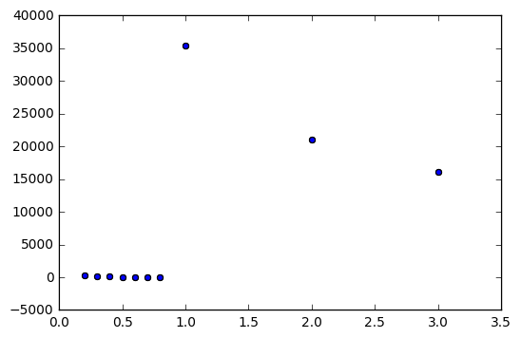
3
What did we find in the data
Introducing TfidVectorizer (2)
If
If
change the max_df we will get different counting of the target words:
change the min_df we will get different countings of the target words:
If
Notes:
We made several basic test to the data…… we know you guys did the same test, so I will make this part fast.
In information retrieval, tf–idf, short for term frequency–inverse document frequency, is a numerical statistic that is intended to reflect how important a word is to a document in a collection or corpus.^{[1]:8} It is often used as a weighting factor in information retrieval and text mining. The tf-idf value increases proportionally to the number of times a word appears in the document, but is offset by the frequency of the word in the corpus, which helps to adjust for the fact that some words appear more frequently in general.

Slide 10
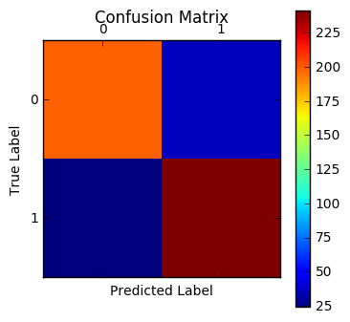
3
What did we find in the data
Test Pipeline
Load the data
Split the data (training / test)
Find the Parameter
Analyze Performance
Evaluate model
Build a Pipeline
Notes:
We made several basic test to the data…… we know you guys did the same test, so I will make this part fast.
In information retrieval, tf–idf, short for term frequency–inverse document frequency, is a numerical statistic that is intended to reflect how important a word is to a document in a collection or corpus.^{[1]:8} It is often used as a weighting factor in information retrieval and text mining. The tf-idf value increases proportionally to the number of times a word appears in the document, but is offset by the frequency of the word in the corpus, which helps to adjust for the fact that some words appear more frequently in general.

Slide 11
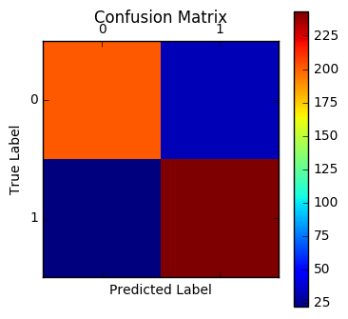

3
What did we find in the data
Some algorithms
LinearSVC
Best Parameter: #21
Precision: 89%
They are the best parameter set for its corresponding classification method because they are selected by GridSearchCV function.
72
Notes:
We made several basic test to the data…… we know you guys did the same test, so I will make this part fast.
In information retrieval, tf–idf, short for term frequency–inverse document frequency, is a numerical statistic that is intended to reflect how important a word is to a document in a collection or corpus.^{[1]:8} It is often used as a weighting factor in information retrieval and text mining. The tf-idf value increases proportionally to the number of times a word appears in the document, but is offset by the frequency of the word in the corpus, which helps to adjust for the fact that some words appear more frequently in general.

Slide 12
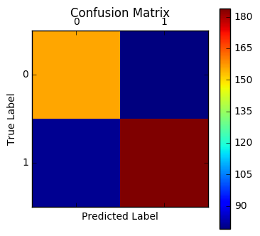
3
What did we find in the data
Some algorithms
KNeighborsClassifier
Best Parameter: #38
Precision: 68%
They are the best parameter set for its corresponding classification method because they are selected by GridSearchCV function.
72
Notes:
We made several basic test to the data…… we know you guys did the same test, so I will make this part fast.
In information retrieval, tf–idf, short for term frequency–inverse document frequency, is a numerical statistic that is intended to reflect how important a word is to a document in a collection or corpus.^{[1]:8} It is often used as a weighting factor in information retrieval and text mining. The tf-idf value increases proportionally to the number of times a word appears in the document, but is offset by the frequency of the word in the corpus, which helps to adjust for the fact that some words appear more frequently in general.

Slide 13

3
What did we find in the data
Which is Better
LinearSVC
Best Parameter: 21, Precision: 89%
KNeighborsClassifier
Best Parameter: 38, Precision: 68%
We choose LinearSVC method with its best parameter set because of higher accuracy rate.
Notes:
* Classifier:
After setting each classifier's optimized parameters, then we could test each classifier using test dataset and compare their confusion matrix/accuracy rate. The LinearSVC's accuracy rate is 0.89. The KNeighborsClassifier's accuracy rate is 0.68. Obviously, we choose LinearSVC method with its best parameter set because of higher accuracy rate.

Slide 14
3
What did we find in the data
ONE example where the prediction was incorrect.
The first one is the file cv978_20929, which should be a positive review however we predict it as a negative one. There're two main reasons we think to explain the error: 1. There're too many negative words in this review since it is a horrible movie. Even though the writer want to express an appreciate on this horrible movie, it still need too much negative words to describe the plot like "kill", "crime", "jail" and so on. Because of these negative words, we may get the wrong prediction.
cv978_20929
Pos->Neg
The second one is the file cv296_12251, which also should be a positive review however we predict it as a negative one. The main reason is that he uses a few possible words. So that even the author doesn't use many negative words, it still can't be predicted as a possible one easily. Also the words "tear", "just" promote the review predicted as a negative review.
cv296_12251
Pos->Neg
Notes:
We made several basic test to the data…… we know you guys did the same test, so I will make this part fast.
In information retrieval, tf–idf, short for term frequency–inverse document frequency, is a numerical statistic that is intended to reflect how important a word is to a document in a collection or corpus.^{[1]:8} It is often used as a weighting factor in information retrieval and text mining. The tf-idf value increases proportionally to the number of times a word appears in the document, but is offset by the frequency of the word in the corpus, which helps to adjust for the fact that some words appear more frequently in general.
LinearSVC best predicted test

Slide 15
Further try
1
Motivation about the data
How did we analyze the data
What did we find in the data
Further try
2
3
4

Slide 16
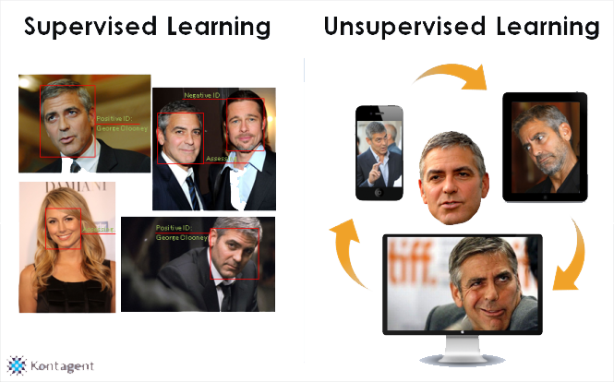
4
Further try
The different between Supervised and Unsupervised
http://dataconomy.com/whats-the-difference-between-supervised-and-unsupervised-learning/

Slide 17
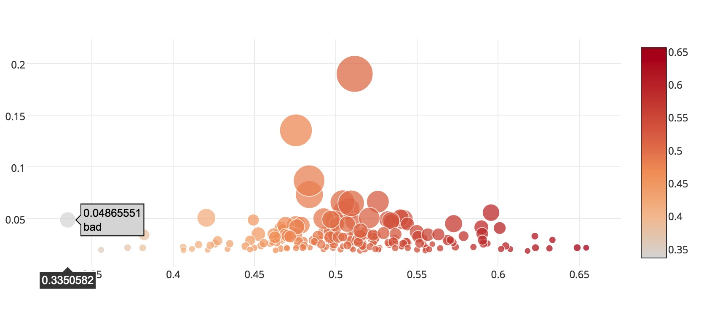
4
Further try
With Supervised Learning
Avg TF-IDF
Most Negative
Positive %
Avg TF-IDF
Most Positive
Positive %

Slide 18
4
Further try
What if
Data have no labels

Slide 19
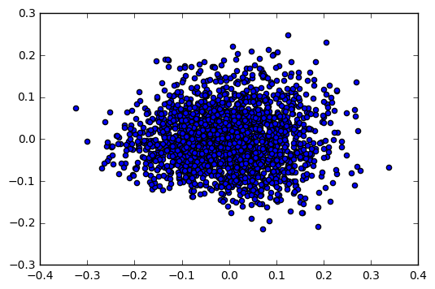
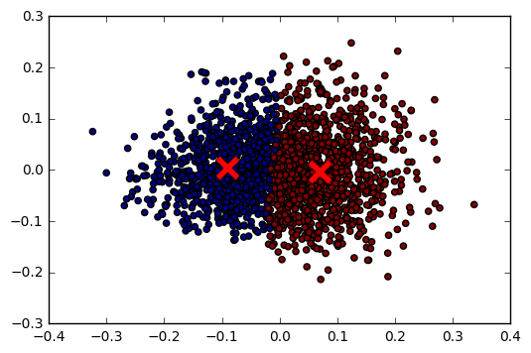
4
Further try
With Unsupervised Learning
Frequency Matrix + TF-IDF
PCA
Clustering(K-means)
Notes:
Vairables diff

Slide 20
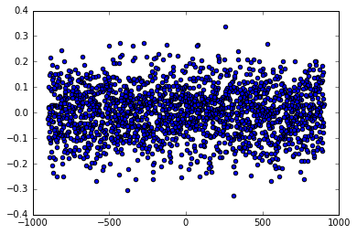
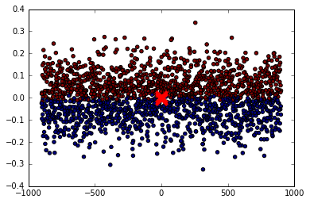
4
Further try
With Unsupervised Learning
Frequency Matrix + TF-IDF + From which Reviews
PCA
Clustering(K-means)
Notes:
Vairables diff

Slide 21
4
Further try
Why this method?
1. Data not always with labels in real world.
2. PCA reduce dimension / no labels.
3. K-means is a common used clustering method.

Slide 22
Conclusion
Conclusion
Now, we could distinguish good movies and bad movies by classifying/clustering their reviews then we could suggest our BOSS which movies we should select.

Slide 23
Thank You

Slide 24
CItation
Bo Pang and Lillian Lee, Seeing stars: Exploiting class relationships for sentiment categorization with respect to rating scales, Proceedings of ACL 2005.
http://dataconomy.com/whats-the-difference-between-supervised-and-unsupervised-learning/
Notes:
We made several basic test to the data…… we know you guys did the same test, so I will make this part fast.
In information retrieval, tf–idf, short for term frequency–inverse document frequency, is a numerical statistic that is intended to reflect how important a word is to a document in a collection or corpus.^{[1]:8} It is often used as a weighting factor in information retrieval and text mining. The tf-idf value increases proportionally to the number of times a word appears in the document, but is offset by the frequency of the word in the corpus, which helps to adjust for the fact that some words appear more frequently in general.
LinearSVC best predicted test

